Slide 1
Customer Defaulting Modelling
Tyro
Ammar M.

Slide 2
Summery
Objective
A model to predict customer defaulting based on customer EFTPOS transactions
Solution
The suggested solution is an optimized classification model(XGBoost) with features include the customer recent behavior, i.e., considering the last N transactions.

Slide 3
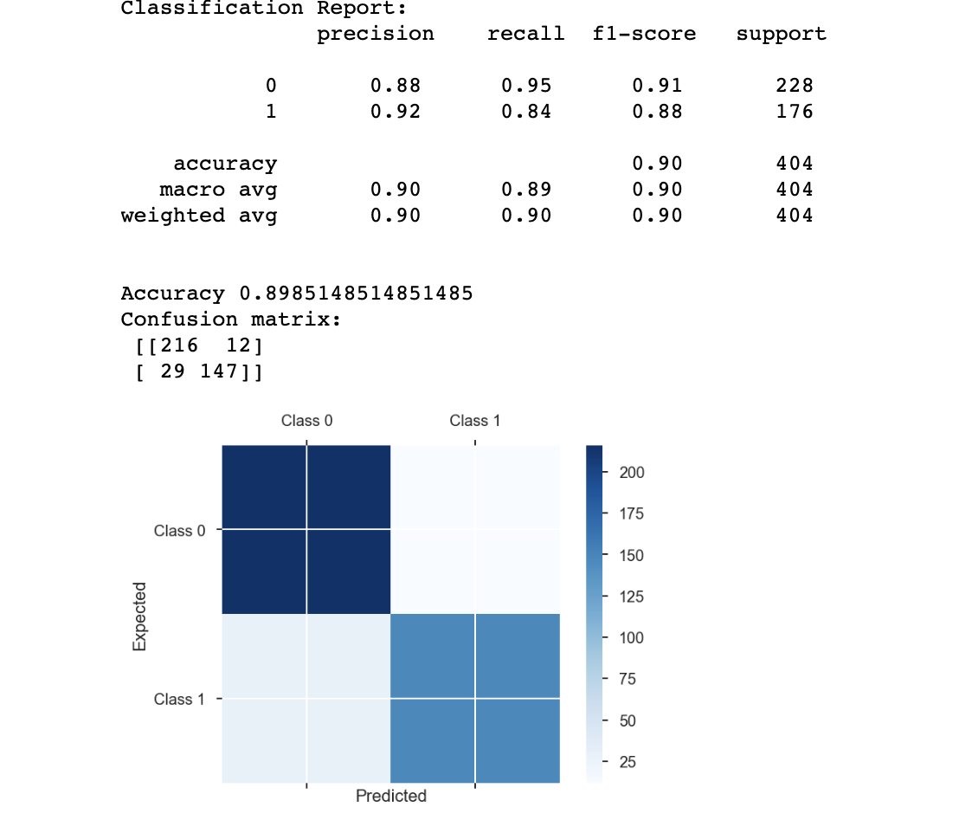
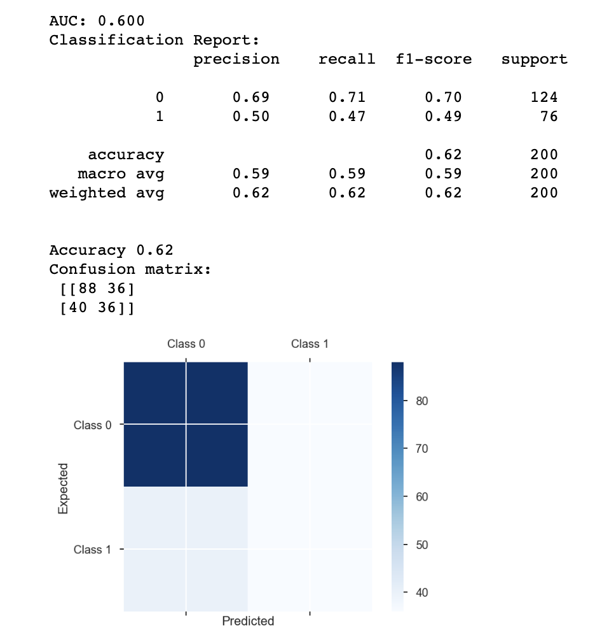
Result
The suggested solution is an optimized classification model(XGBoost) with features include the customer recent behavior, i.e., considering the last N transactions.
Training
Testing

Slide 4
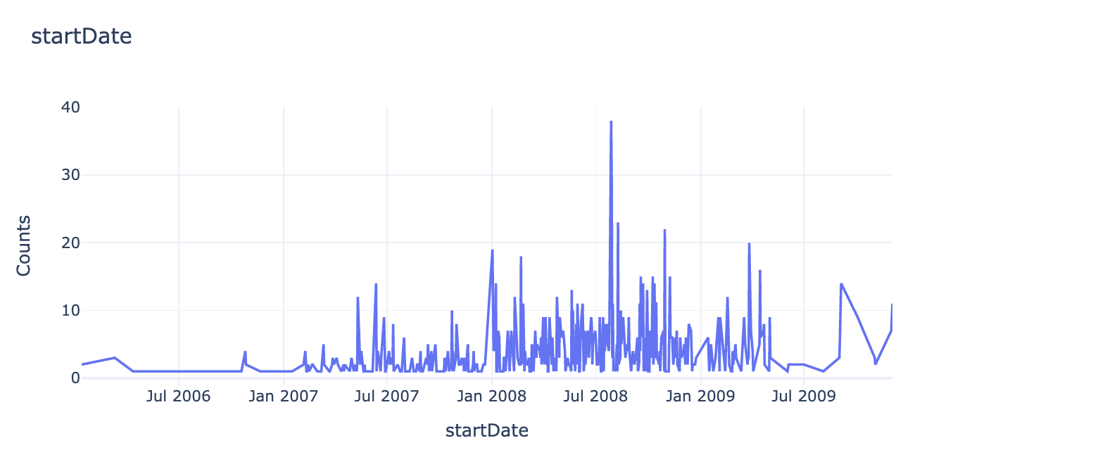
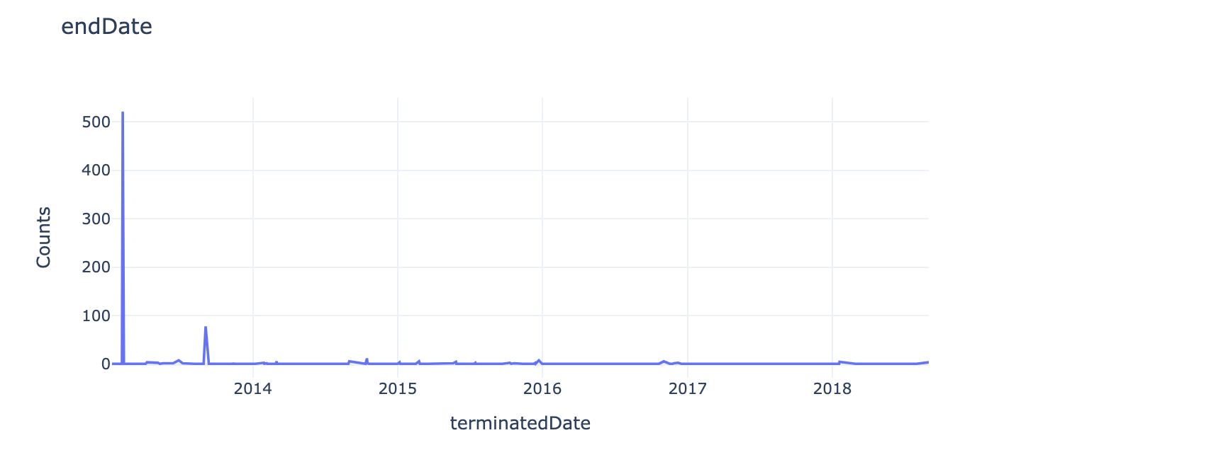
Expletory Data Analysis (Contract Periods)
Customer data: 'customer_id', 'startDate', 'firstTransactionDate', 'terminatedDate'
Transaction data: 'date', 'customer_id', 'industry', 'location', 'monthly_amount', 'daily_average_amount', 'daily_sd_amount’
Most of the customers ended their contract on Feb 2013

Slide 5
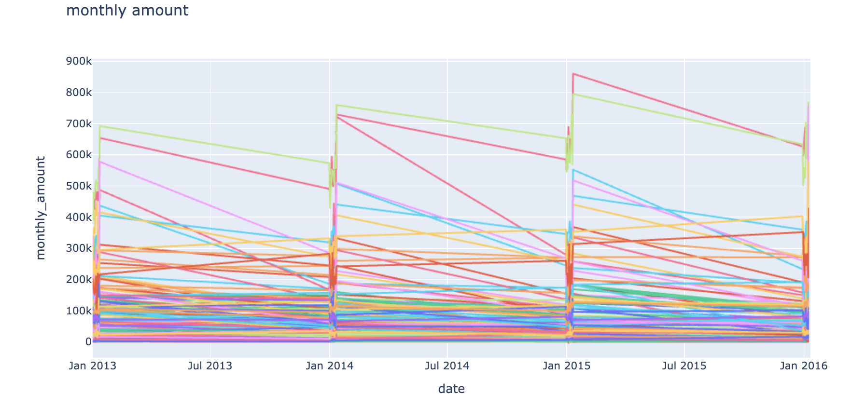
Expletory Data Analysis (Transactions)
The criteria to define a customer being defaulting is not clear
Data is given only for January of each year

Slide 6
Modelling
The task is formed as a classification problem based on XGBoost
Features:'date', 'customer_id', 'industry', 'location', 'monthly_amount', 'daily_average_amount', 'daily_sd_amount', 'startDate', 'firstTransactionDate', 'terminatedDate', 'Tenure', 'year', 'month', 'class', 'monthly_amount_1', 'daily_average_amount_1', 'daily_sd_amount_1', 'monthly_amount_2', 'daily_average_amount_2', 'daily_sd_amount_2', 'monthly_amount_3', 'daily_average_amount_3', 'daily_sd_amount_3', 'monthly_amount_4', 'daily_average_amount_4', 'daily_sd_amount_4’
The hypothesis is that recent money transactions impact customers defaulting
The hyperparameters of the model are optimized using Bayesian search
Other modeling could be tried as well. For example to consider the problem as time series.

Slide 7
Model interpretation

Slide 8
Conclusion
More granularity of the data could be more helpful, i.e., data for all the months without aggregation
Customer defaulting based on end of contract is questionable.
More features about the customer are needed, for example the loan amount and the number of times the customer applied for a loan
While the problem is considered as a classification. A personalized modelling can be also tried, i.e., predict the transaction amount for each customer and if it is going to fall too much compared with the loan.

